Slide 1
FINAL PORTFOLIO DECK · v1.0
Customer Segmentation & CRM Intelligence Platform
From raw transactions to an Agentic AI decision system — in 9 phases, on a real-world retail dataset.
Avelabs · Data Analyst / Data Scientist track · UCI Online Retail (Dec 2010 – Dec 2011)

Slide 2
WHY THIS PROJECT — POSITIONING
2 / 18
Built to mirror an Avelabs client engagement
Not a coding exercise
Structured as a consulting engagement with stakeholders, KPIs, hypothesis register, and decision-system thinking.
Avelabs-shaped scope
Customer Analytics · CRM Intelligence · ML Segmentation · Agentic AI — the exact stack Avelabs delivers to retail, fashion, beauty and platform clients.
Output is a decision system
Not a model. The deliverable wraps analytics into named campaigns, churn alerts, and revenue-opportunity quantification any CMO can act on.
Customer Segmentation & CRM Intelligence Platform · Final Portfolio · v1.0

Slide 3
THE 9-PHASE ROADMAP
3 / 18
Business framing → analytics → ML → Agentic AI → application package
1. Business Understanding
6. ML Segmentation
Stakeholders · KPIs · 7 hypotheses
5 personas · K-means · PCA
2. Dataset Understanding
7. AI Marketing Agent
Cleaned 392K rows · 4,338 customers · £8.89M
Agentic AI · system design · prototype
3. Exploratory Data Analysis
8. Resume Integration
H1, H2, H4 confirmed
Bullets · LinkedIn · STAR · EN+KR
4. Customer Analytics
9. Application Package
CLV · cohort retention · H3 at 11.9×
Resume PDF · master deck · interview kit
5. RFM Segmentation
9 segments · H5 · £1.06M recoverable
Customer Segmentation & CRM Intelligence Platform · Final Portfolio · v1.0

Slide 4
HEADLINE OUTCOMES
4 / 18
5 numbers that tell the whole story
11.9×
£1.06M
689
0.72
22
Fast 2nd-buyer CLV multiplier
Recoverable revenue pool
VIP B2B accounts surfaced by ML
Gini coefficient · top 20% = 75% of revenue
Business-captioned hero charts
vs. one-time buyers (predicted 3×, observed 11.9×)
in dormant-but-loyal customers (1,170 accounts)
16% of base · 60% of revenue · 13× more than manual top-50
re-framed the entire CRM strategy
every visual tied to a CRM action
Customer Segmentation & CRM Intelligence Platform · Final Portfolio · v1.0

Slide 5
PHASE 1 — THE STRATEGIC RE-FRAMING
5 / 18
"Not an acquisition problem. A customer intelligence problem."
The original brief asked for customer acquisition. Lorenz-curve analysis showed:
• Top 1% of customers contribute 31.8% of revenue
• Top 20% contribute 75% of revenue (Gini 0.72)
• A churn event in the top 1% is a multi-£10k revenue line item
Re-framed the engagement before writing a line of code:
→ From "spend more on ads" to "extract more value from existing customers."
This single re-framing changed the scope from a one-off campaign to a CRM intelligence platform.
Customer Segmentation & CRM Intelligence Platform · Final Portfolio · v1.0

Slide 6
PHASE 2 — DATA QUALITY DISCIPLINE
6 / 18
We dropped 27% of rows. We kept 99.2% of customers.
5 documented cleaning steps · every drop tied to a business rule:
1. Drop cancellations
9,288 rows (InvoiceNo starts with C)
2. Drop missing CustomerID
133,361 rows (guest checkouts — not assignable to CRM)
3. Keep Quantity > 0
residual returns
4. Keep UnitPrice > 0
40 rows (free samples + bad-debt adjustments)
5. Drop duplicates
5,192 rows (double-scans / system replay)
Result: 541,909 raw → 392,692 cleaned · 4,338 customers · £8.89M revenue retained (91% of raw).
Outliers (Quantity up to ±80,995) were KEPT — they are real B2B-scale activity, not data errors. That judgment call directly enabled Hypothesis H4 (hidden B2B) in Phase 6.
Customer Segmentation & CRM Intelligence Platform · Final Portfolio · v1.0

Slide 7
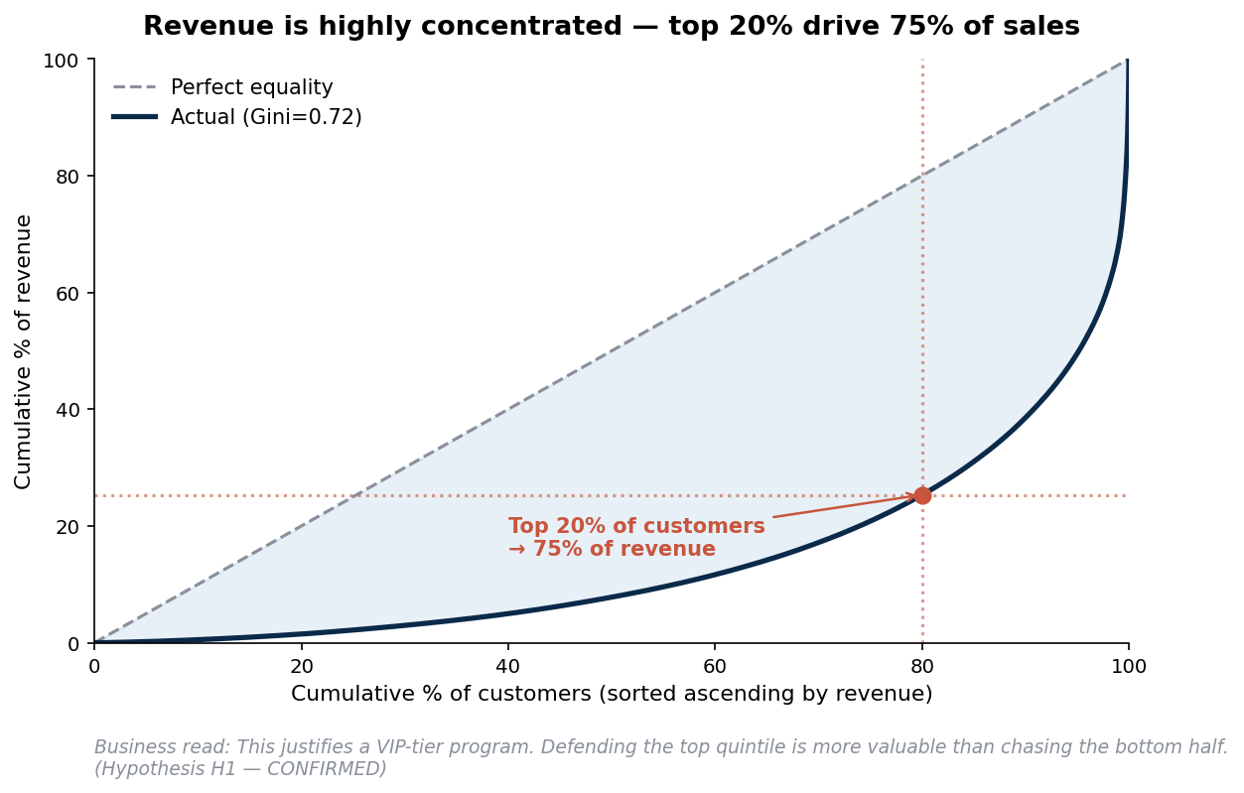
PHASE 3 — EDA · REVENUE CONCENTRATION
7 / 18
Top 20% of customers drive 75% of revenue · Gini 0.72
H1 → CONFIRMED
H2 → CONFIRMED (Intl AOV 1.9× UK)
H4 → CONFIRMED (hidden B2B)
H6 → DIRECTIONAL (Q4 dominates)
The CMO read-out: • Defend the top 20% — they ARE the business. • Build a VIP program — non-optional. • Stop spraying budget evenly across the base.
Customer Segmentation & CRM Intelligence Platform · Final Portfolio · v1.0

Slide 8
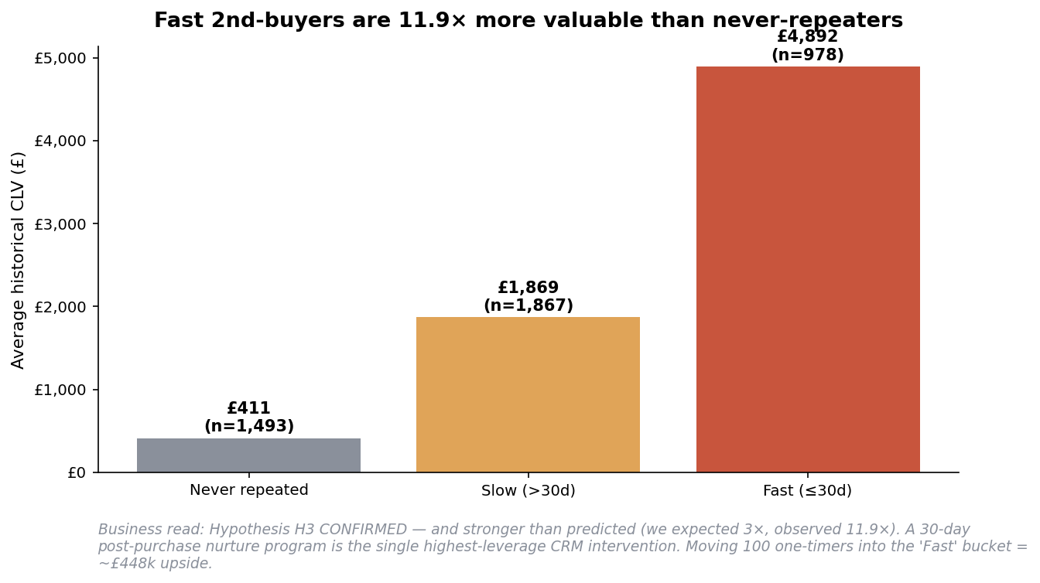
PHASE 4 — THE 11.9× FINDING
8 / 18
Fast 2nd-purchasers have 11.9× the CLV of one-timers
Predicted: 3×
Observed: 11.9×
Why this matters: Shifting 100 one-timers into the Fast cohort = ~£448k incremental revenue. The 30-day post-purchase nurture is the single highest-leverage CRM lever in the project.
Customer Segmentation & CRM Intelligence Platform · Final Portfolio · v1.0

Slide 9
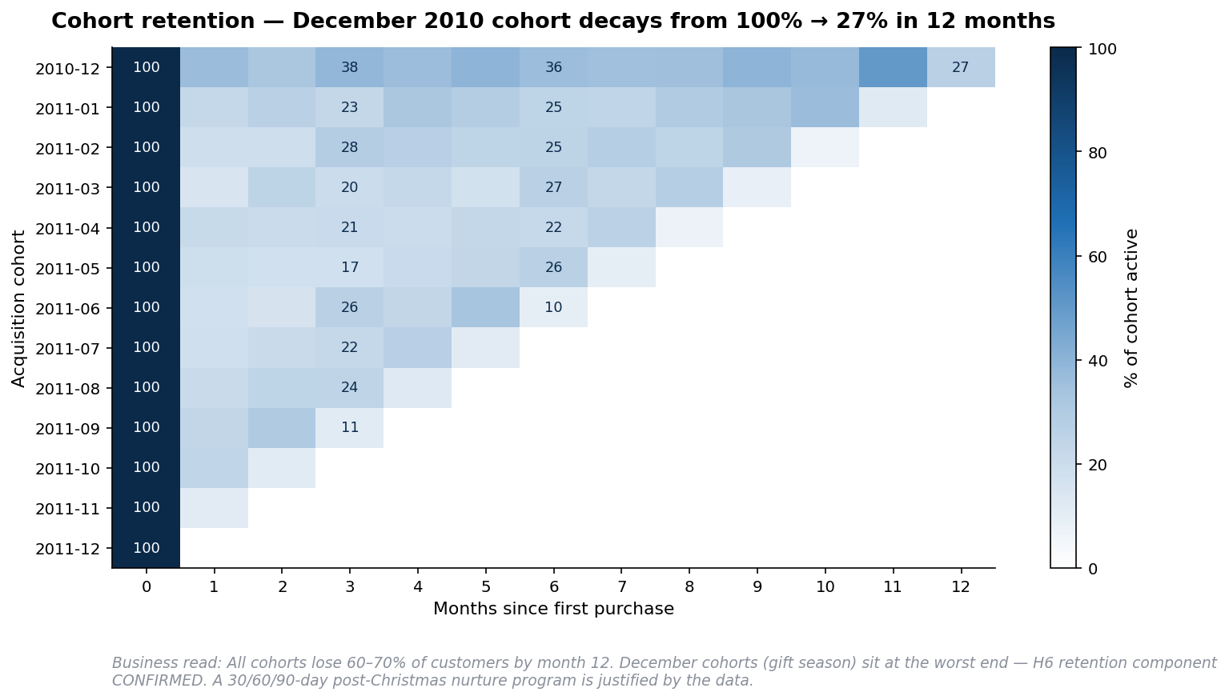
PHASE 4 — COHORT RETENTION
9 / 18
60-75% of customers go dormant within 12 months
Surprising finding: Dec 2010 cohort retains BETTER than 2011 cohorts at month 12 (27% vs 10-25%). Gift-season buyers aren't worse — they need a different nurture path.
Customer Segmentation & CRM Intelligence Platform · Final Portfolio · v1.0

Slide 10
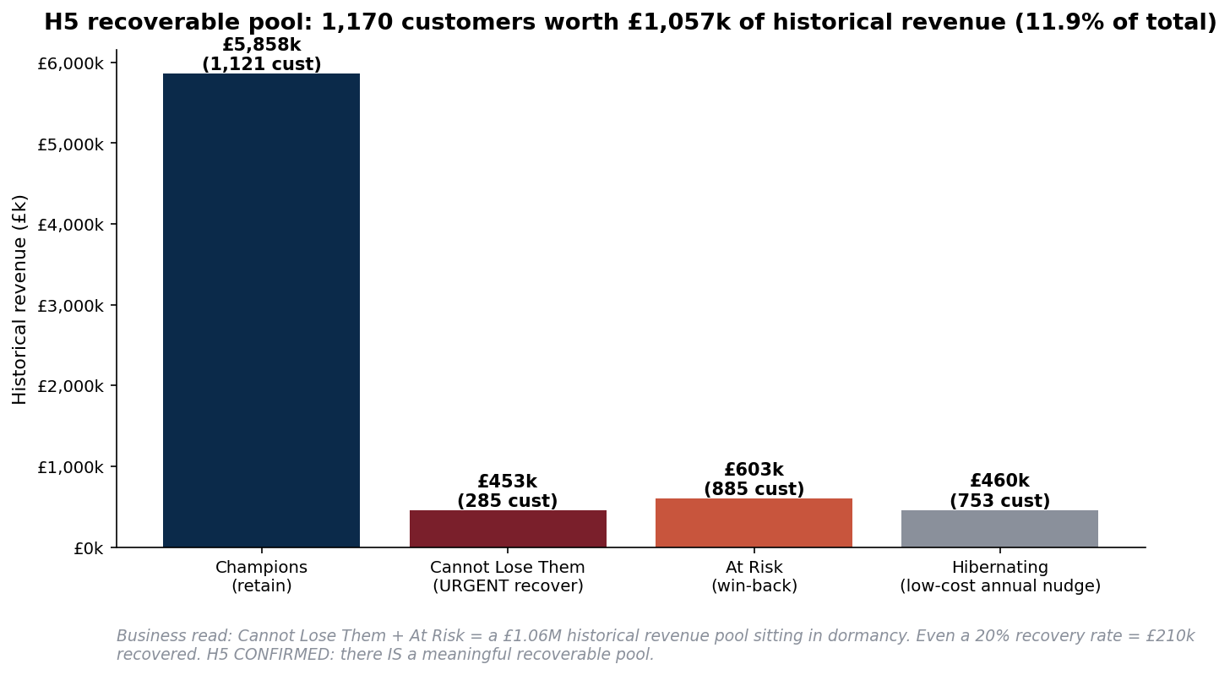
PHASE 5 — RFM CRM PLAYBOOK
10 / 18
9 segments · 9 named campaigns · 1 £1.06M recoverable pool
H5 → CONFIRMED
1,170 customers in At-Risk + Cannot Lose Them £1.06M historical revenue 11.9% of total revenue Even 20% recovery = ~£210k recovered. Reallocate budget from Hibernating (5.2% rev, low recovery) to Cannot Lose Them (5.1% rev, proven loyalty).
Customer Segmentation & CRM Intelligence Platform · Final Portfolio · v1.0

Slide 11
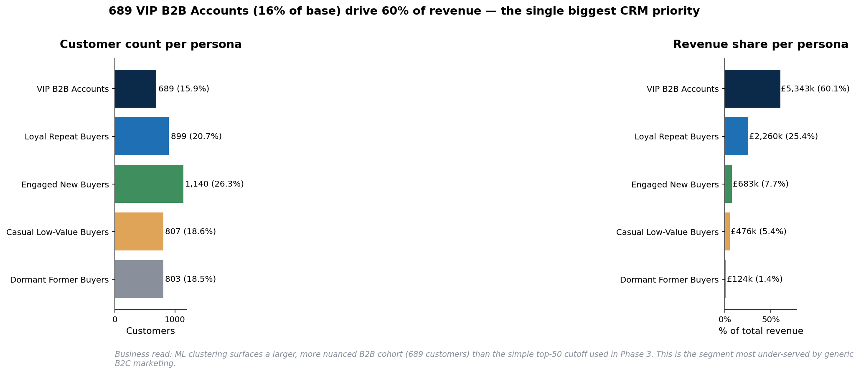
PHASE 6 — ML SEGMENTATION
11 / 18
5 personas · K-means · K=5 chosen for interpretability, not silhouette
VIP B2B Accounts: 689 customers (16% of base) drive 60% of revenue — 13× larger than manual top-50.
Customer Segmentation & CRM Intelligence Platform · Final Portfolio · v1.0

Slide 12
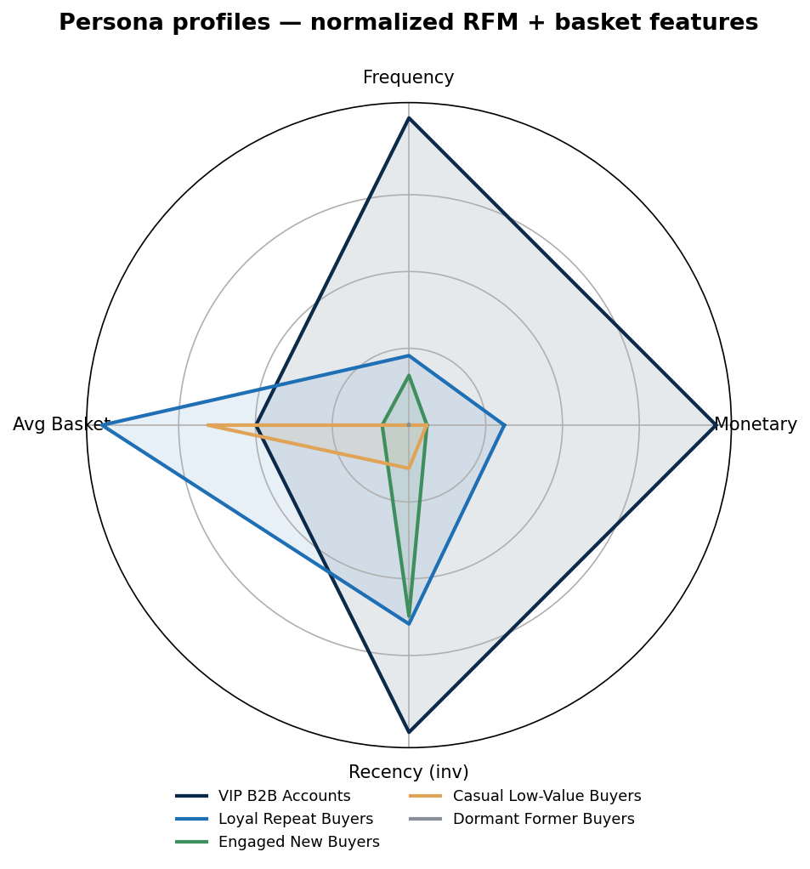
PHASE 6 — PERSONA FINGERPRINTS
12 / 18
Each persona has a distinct multi-dimensional signature
VIP B2B = high on EVERY dimension. Dormant = low on every. The radar makes them visually unmistakable.
Customer Segmentation & CRM Intelligence Platform · Final Portfolio · v1.0

Slide 13
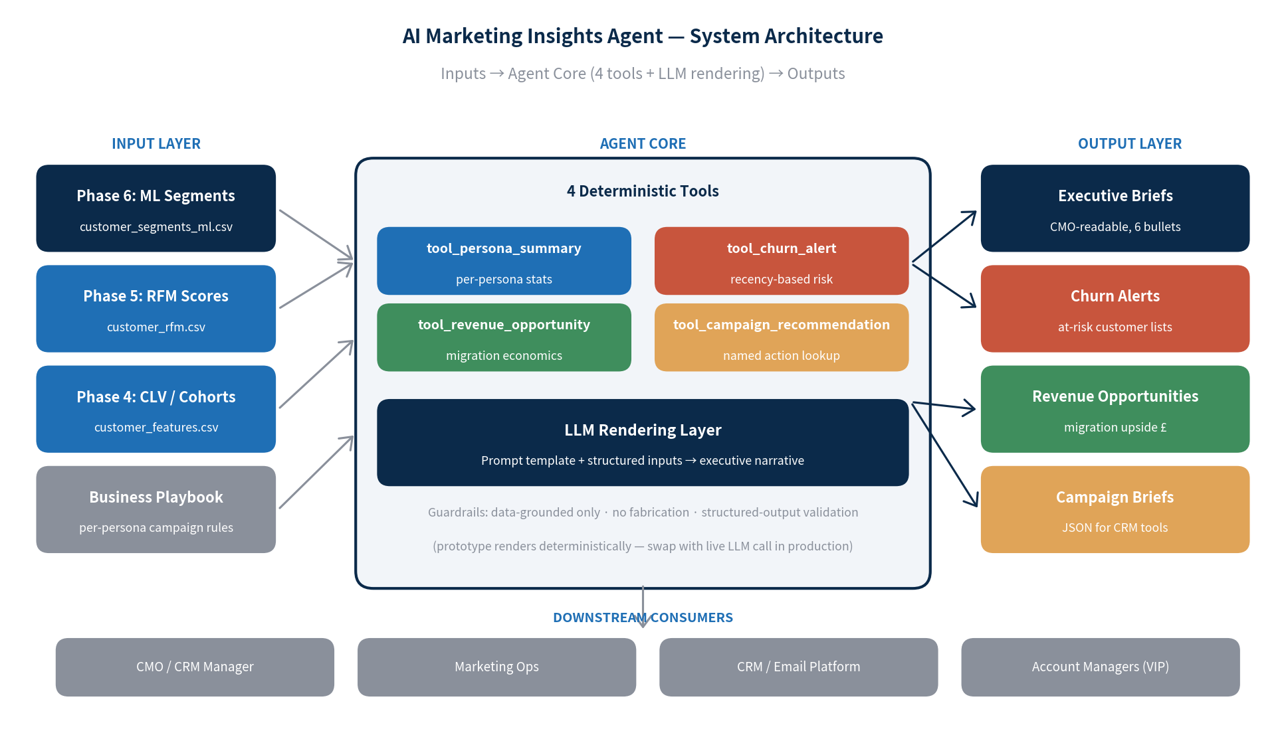
PHASE 7 — AGENTIC AI ARCHITECTURE
13 / 18
The LLM renders. The tools decide. No fabrication.
4 deterministic tools feed an LLM rendering layer. Hallucination eliminated by construction — not by hoping.
Customer Segmentation & CRM Intelligence Platform · Final Portfolio · v1.0

Slide 14
PHASE 7 — AGENT IN ACTION
14 / 18
Sample executive brief generated for VIP B2B Accounts
Who they are
689 customers (15.9% of base). Avg historical value £7,755 · 14 orders avg · 11 days recency.
Why they matter
£5.34M (60.1% of total revenue). The CRM budget MUST respect this concentration.
Top risk
Customers crossing 30-day dormancy line surfaced with top-5 to recover — names + £-figures.
Recommended campaign
Named Account Program · highest priority · AM + personalized email · highest per-customer spend.
KPIs
Account retention rate · revenue per account YoY · NPS
Customer Segmentation & CRM Intelligence Platform · Final Portfolio · v1.0

Slide 15
BUSINESS RECOMMENDATIONS — Q1 BUDGET PLAN
15 / 18
Where the next-quarter CRM budget should go
Rank
Persona / Segment
Action
Budget
🔴 1
VIP B2B Accounts
Named Account Program — AM outreach, custom pricing
Highest per-cust
🔴 2
Engaged New Buyers
30-Day Nurture (H3 — 11.9× CLV multiplier)
Medium · highest aggregate ROI
🟡 3
Loyal Repeat Buyers
Tier-Up to VIP campaigns
High
🟡 4
Cannot Lose Them
AM outreach · custom offer
Highest per-cust
🟢 5
At Risk
Win-back campaign
High aggregate
⚪ 6
Hibernating
Annual touch only · suppress
Lowest
Customer Segmentation & CRM Intelligence Platform · Final Portfolio · v1.0

Slide 16
HYPOTHESIS REGISTER — VERDICTS
16 / 18
6 of 7 hypotheses tested and confirmed by the data
#
Hypothesis
Verdict
Evidence
H1
Top 20% drive ≥70% of revenue
✅ CONFIRMED
75% · Gini 0.72
H2
International AOV > UK AOV
✅ CONFIRMED
£850 vs £438 (1.9×)
H3
Fast 2nd-buy → 3× LTV
✅ STRONGER
11.9× (4× higher than predicted)
H4
Hidden B2B segment
✅ STRONGER
689 customers · 13× larger than manual top-50
H5
Dormant-loyal recoverable
✅ CONFIRMED
£1.06M pool · 1,170 customers
H6
Gift-season cohort behavior
✅ CONFIRMED
Q4 spike + 27% retention at m12
H7
Returns concentrated
⏳ DEFERRED
Future work
Customer Segmentation & CRM Intelligence Platform · Final Portfolio · v1.0

Slide 17
WHAT I WOULD DO IN MY FIRST 90 DAYS
17 / 18
Day-1-ready on an Avelabs client engagement
Weeks 1-2 — Onboard + Audit
Map client data sources · run a 5-step quality framework · identify the equivalent of "missing CustomerID 25%" landmines before they bite downstream analyses.
Weeks 3-6 — Foundation
RFM scoring · cohort retention · CLV distribution · Pareto / Lorenz reads. Deliver the executive read-out FIRST, then the notebook.
Weeks 7-10 — Segmentation
ML clustering on the client base · cross-validate vs. rules-based segmentation · produce per-persona campaign briefs.
Weeks 11-13 — AI Layer
Design a client-specific decision-support agent following the same "LLM renders, tools decide" architecture. Live LLM swap-in.
Customer Segmentation & CRM Intelligence Platform · Final Portfolio · v1.0

Slide 18
READY TO DISCUSS
Let's build the next one for Avelabs.
Full notebooks, system design DOCX, segmentation deck, AI architecture deck, and 22 charts available on GitHub.
[Your Name] · [email] · [LinkedIn URL] · [GitHub URL]

